Slide 1
Project Management (PS)
Curriculum: Introduction to S/4HANA using Global Bike

Slide 2

4.3 (July 2025)
S/4HANA 2023
Fiori 3.0
Global Bike
No Prerequisites needed

Slide 3
Martin Wassmann
Bret Wagner
Stefan Weidner
Babett Ruß
Beginner

Slide 4
You are able to
define the central organizational structures of the PS module.
summarize the master data which is most important for the PS module.
explain a standard process of the Project Management.

Slide 5
Agenda
PS Organizational Structure
PS Master Data
PS Processes
  Project Planning
  Project Execution
  Project Closure

Slide 6
Agenda
PS Organizational Structure
PS Master Data
PS Processes
  Project Planning
  Project Execution
  Project Closure

Slide 7
PS Organizational Structure (Project Management)
Organizational structure needs to be defined in order to define execution of project
  Project system itself does not own its own organizational structure
  PS inherits it's organization structures via assignment into organizational units in the enterprise structure
  The PS module is integrated to the modules Finance and Logistics
  The productivity of this module is mainly created through the integration of other SAP modules
Sales order execution
in Project Management
Sales and Distribution (SD)
Business Requirements in Project Management
Controlling (CO)
Finance (FI)
Materials Management
(MM)

Slide 8
Agenda
PS Organizational Structure
PS Master Data
PS Processes
  Project Planning
  Project Execution
  Project Closure

Slide 9
PS Master Data
Projects
WBS-Elements (Project Structure Plan Elements)
Sequences
Milestones
Work Data

Slide 10

Projects
Characteristics of projects:
  Complex
  Unique
  High risk
  Goal oriented
  Limited in time, costly, high capacities needed
  Strategic meaning
  High quality standards
Project types:
  Customer projects
  Overhead cost projects
  Investment projects

Slide 11
Display Projects
Projects are complex tasks that can be found in several components in the SAP system:
    Sales and Distribution
    Controlling
    Finance
    Materials Management

Slide 12
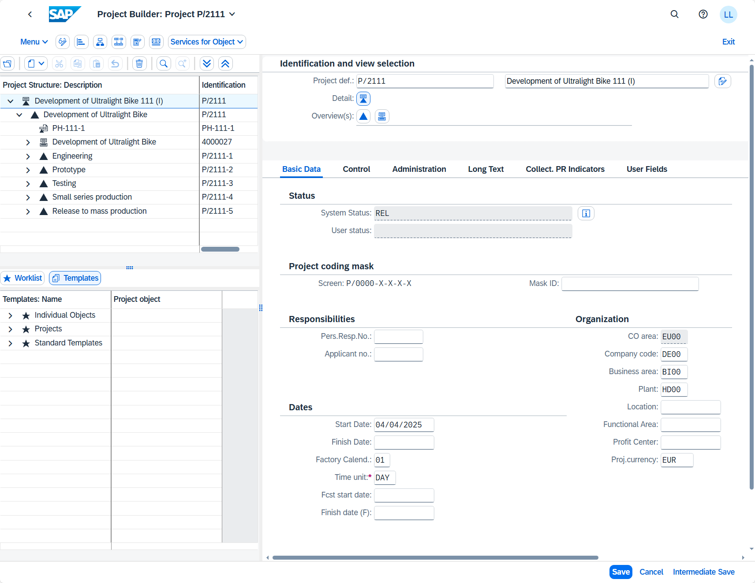
Project Builder
All data is prepared using one transaction
Regularly performed projects can be re-used
to the work of creating them.
Scheduling of projects is based on networks

Slide 13
WBS-Elements
The WBS-Element either describes a specific tasks or subtasks that can be further broken down in to work packages→ Work package
Possible Status for WBS Elements
  Released→ Entry of effective costs possible
  Unlocked
  Technically complete
  Closed→ processes in Logistics and Finance
  Deletion flag
  Fully invoiced→ further invoices can be inhibited
Notes:
Further statuses exist for WBS elements that are not recalled here:
The status for standard WBS is valid for all WBS elements
In addition to the given system status, user statuses can be defined

Slide 14
Hierarchy Graphic (PSP)
The Hierarchy Graphic forms the basis for planning:
  Costs
  Revenues
  Payments
  Budgets
  Schedules
Can be structured in phases, functions and objects like conceptual design, overall planing or permissions.
Project phases are, for instance:
  Conceptual design
  Overall planning
  Permission, etc.

Slide 15
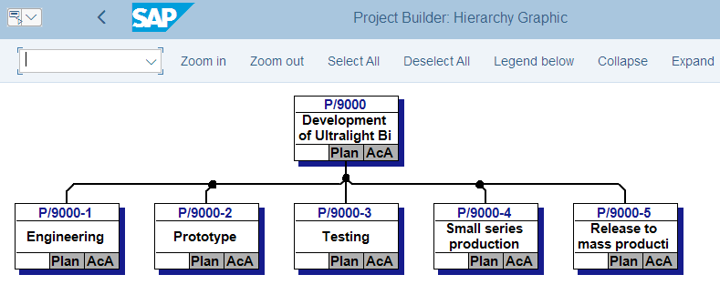
Hierarchy Graphic
Functions:
Scheduling, Cost Determination, Classification in Entities
Notes:
In the Hierarchy,WBS elements are subordinated:
- When structuring objects, objects with same features can be displayed using a seperate hierarchical structure: project summarization
- Planning is done using processes that are assigned to WBS elements

Slide 16
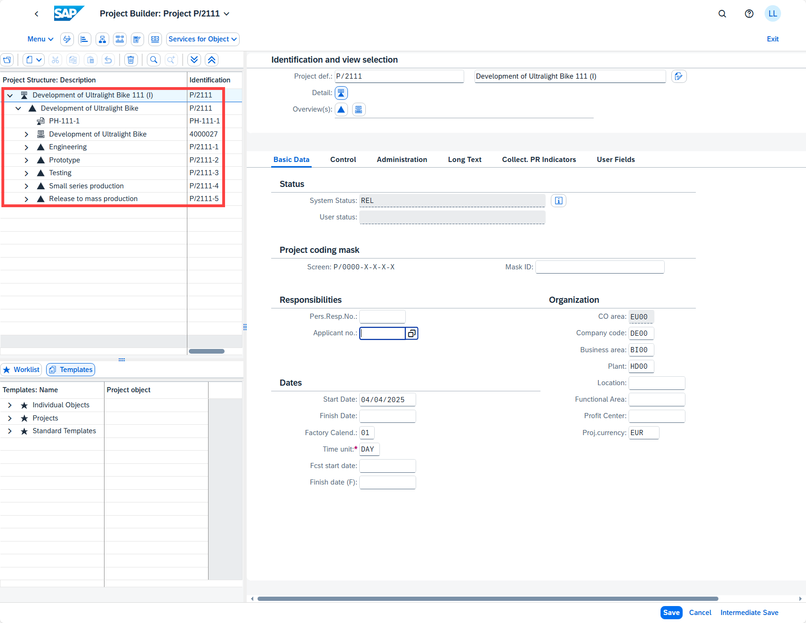
Project Structure in SAP S/4HANA
Project Structure
Project + PSP Elements

Slide 17
Activities
The Project System distinguishes between the following types of activity:
Internally processed activities
Externally processed activities
General costs activities
The German standard DIN 69 900 describes activities as "components of a process " with the following characteristics:
They have a duration.
They have a defined start and a defined finish.
They are processed without interruption.
Resources are needed to execute them.
They incur costs.

Slide 18
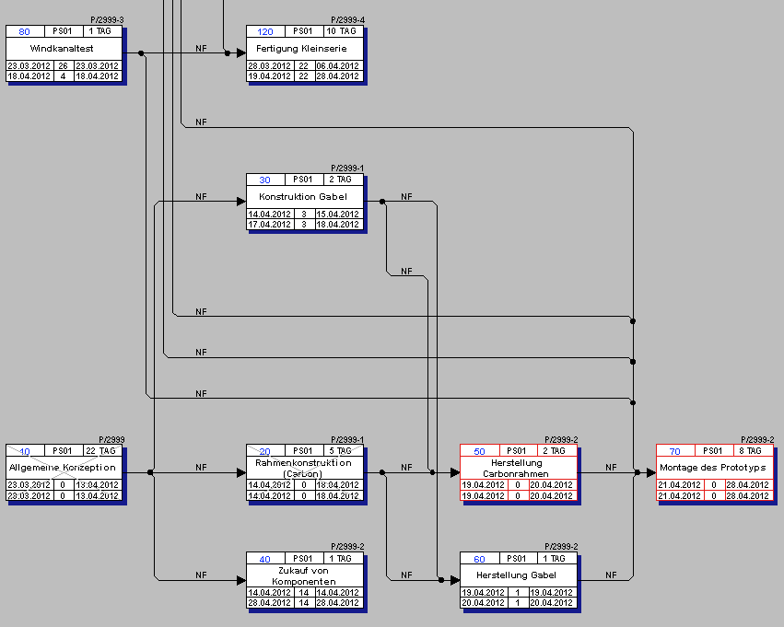
Hierarchy Graphic
Example Hierarchy Graphic
Consists of access sequences and relationships
Possibility to create access sequences in external
processing
Change of internally processed activities to
externally processed ones
Notes:
Hierarchy Graphic defined in Customizing
Head:
Data is saved and taken over to the complete schedule, e.g.:
System status
Calculation data
e.g.:
Consists of normal series
Depending on status, elements are depicted differently

Slide 19



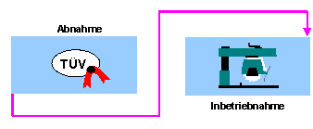
Relationships
Relationships describe the chronological sequence in a network plan oder standard network. There can be dependencies of a technical or logical nature.
Normal series
From the end of one series to the beginning of another one.
Start series
From the Beginning of one Series to the beginning of another one.
End series
Starting at the end of one series going to the end of another series.
Bounding series
From the beginning of one series to the end of another series.
Notes:
The type of the relationship determines how the individual activities are linked with each other.
Finish - Start (FS) Relationship
This is the relationship between the end of an activity to the beginning of the following activity. In the graphic, the "assembly" activity cannot start before the "production" activity has finished.
This graphic is explained in the accompanying text
Start - Start (SS) Relationship
This is the relationship between the beginning of an activity to the beginning of the following activity. In the figure, the "component procurement" activity cannot start before the "design" activity has started.
This graphic is explained in the accompanying text
Finish - Finish (FF) Relationship
This is the relationship between the end of an activity to the end of the following activity. In the figure, the "work scheduling" activity cannot finish before the "design" activity has finished.
This graphic is explained in the accompanying text
Start - Finish (SF) Relationship
Relationship from the beginning of an activity to the end of the following activity. In the figure, the "start-up" activity "start-up" cannot finish before the "inspection" activity has started.
This graphic is explained in the accompanying text
Note
SF relationships are seldom used in practice. You can usually change SF relationships to FS relationships by changing the sequence of the activities.
Here's the link:
https://help.sap.com/erp2005_ehp_06/helpdata/EN/a9/8a853488601e33e10000009b38f83b/frameset.htm

Slide 20
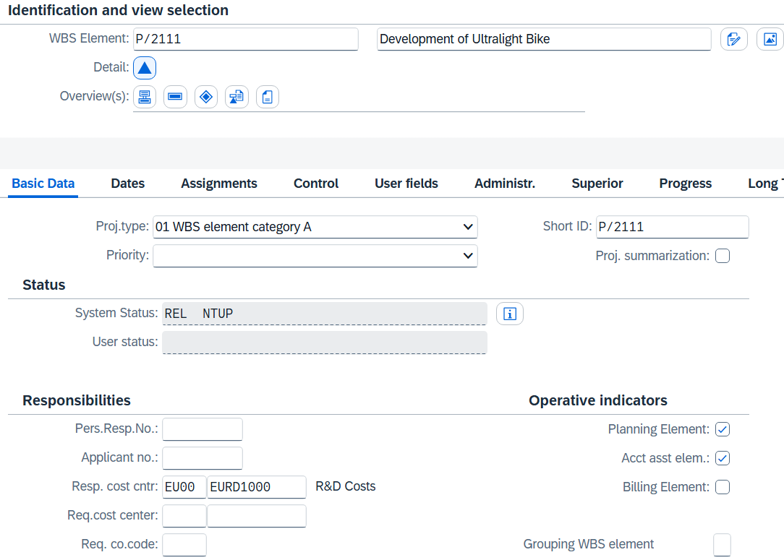
Milestones
Milestones are used to mark transitions between different phases or departments
In the project system, they can be used for additional tasks and functions
Milestones are created in the Project Builder for Single Elements
Notes:
Milestones can be used for the following tasks:
Milestone Trend Analysis (MTA)
Milestone trend analysis is a simple and effective method of controlling dates in a project. The milestone dates on different report dates are compared. In the graphical MTA chart you recognize trends and delays immediately.
Conducting earned value analysis using the milestone technique
The milestone technique is one of the measurement techniques for determining the earned value in earned value analysis. Each milestone represents the portion of the work that is completed in an activity or in a WBS element.
Determining Dates in the Billing Plan
A milestone is linked with a date in the billing plan. When the milestone is reached, the actual date of the milestone is copied into the billing plan.
Triggering predefined Milestone Functions
You trigger a series of events to process a particular business process with milestone functions.

Slide 21
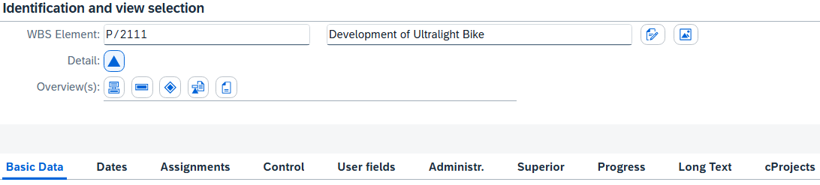
Milestones
For preparation of business actions
Functions:
  Release of activities
  Include standard schedule
  Create hierarchy
  Include parts of hierarchy
  Start workflow tasks
  etc.

Slide 22
Work Data in the Activity
Activity type: If you want to cost networks, you must define an activity type for internal processing and a formula key for calculating costs. When you enter an activity type you can display different costs for special qualifications or weekend work.
Work: Here you specify the planned amount of work involved in carrying out the activity. For example, you can specify the engineering activity in hours or energy requirements in kilowatt hours. Using the value for work and the formula for calculating capacity requirements entered in the work center, the system determines the capacity requirements during scheduling. You can enter basic and forecast data for work in network activities.
Number of Required Capacities: Here you specify how much capacity is required to do the work in the activity, for example, two people or three machines. This number refers to the capacity category, which is entered on the scheduling screen in the work center.
Percent: With this value you specify the percentage of the work that is used in the activity. The percentage is only used when you let the system calculate duration, work, or the number of capacities using the calculation key. If you do not enter a percentage, the system will assume 100%.
Calculation key: You can maintain the data for work, duration, and number of capacities required manually, or, you can let the system determine it using the calculation key.

Slide 23
Services
Planned
  Related to activities that are collected in a service master
Non-Planned
  Related to activities that cannot be specified because it is not known, which individual specifications they comprise.
For preparation of externally processed tasks, the corresponding control key must be entered in the network activity.

Slide 24
Agenda
PS Organizational Structure
PS Master Data
PS Processes
  Project Planning
  Project Execution
  Project Closure

Slide 25
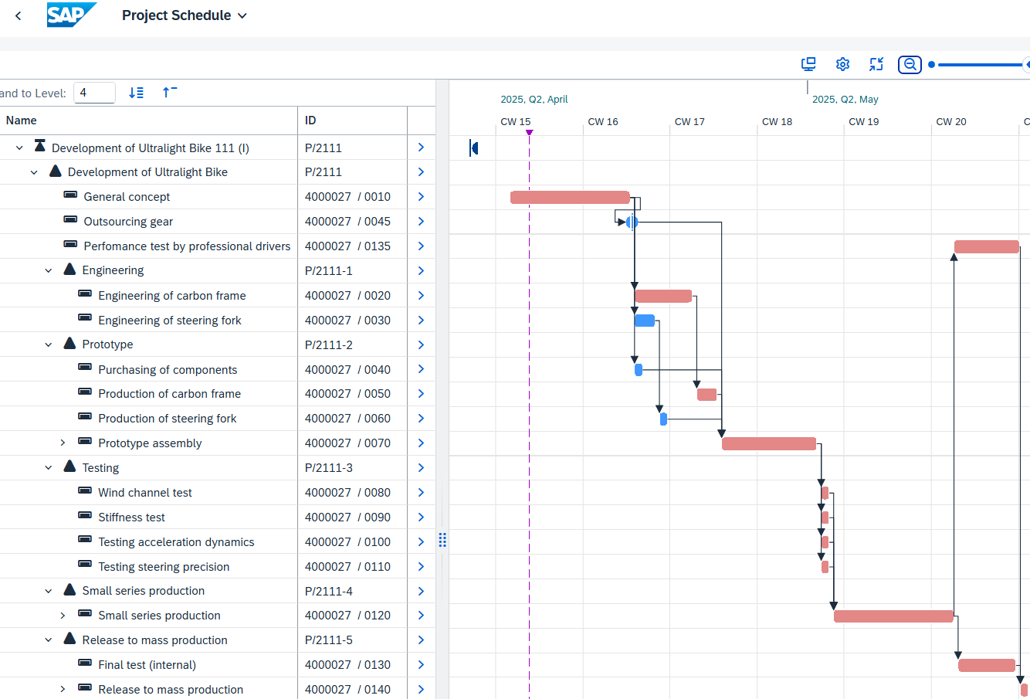
Project Planning – Project Planning Board
Graphical interface for creation and preparation of projects
Function:
  Termination (of resources)
  Coordinate work
  Check capacities
  Calculate costs

Slide 26
Project Execution
Project execution comprises several steps (e.g. purchase process)
When goods receipt of services is executed, times are recorded
Sales orders are generated automatically using the hierarchy
With the execution of services, liabilities and costs for items that were planned using Easy Cost Planning are entered

Slide 27
Project Execution: Easy Cost Planning
Easy Cost Planning enables cost planning based on amounts and characteristics. It is executed on the level of project structures. Main advantages of these is a fast, easy and clearly arranged data acquisition.
Possible entries with Easy Cost Planning:
  Internal accounting for services
  Direct process accounting
  Reservations
  Goods issue
  Purchase requisition
  Sales order

Slide 28
Period Closing
In general, one time per period executed in background
To execute billing, rules are necessary
Costs are given by customer bills and supplier bills etc.; are given to FI and other modules
Direct settlement
Each object is settled directly to the external cost object (examples: cost center, profitability segment)
Multi-level settlement
You settle individual objects in the project to the higher-level WBS element first. This then settles the costs collected to the external receiver.

Slide 29
Information System
The information system is used to evaluate key performance indicators within a project.
Provides the user with available reports and graphs
Overview over performance, schedule and costs
Report types:
  Structure-based
  Cost-oriented
  Item reports
  Summarised reports

